Slide 1
TEAM EMS PRESENTATION
Camilo Aguilar
06/03/13

Slide 2
Active and Reactive Power
Load

Slide 3
Voltage Current
Load

Slide 4
Current Voltage Meassurements
Real Power Consumption (WATTS)
Reactive Power (VAR)
Phase Shift
Capacitor/Resistive/Inductive Circuit
Phase add linearly

Slide 5
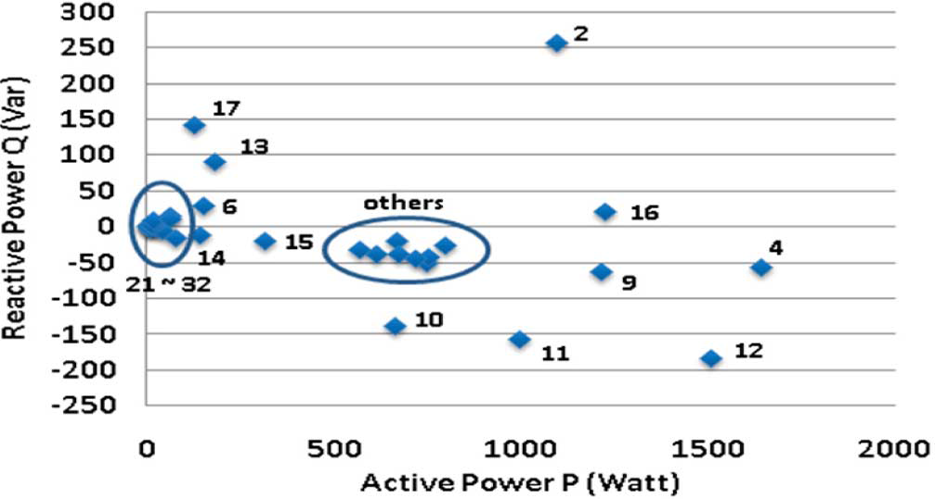

Slide 6
